Slide 1
Thesis Figures

Slide 2
Notes:
Figure 1

Slide 3
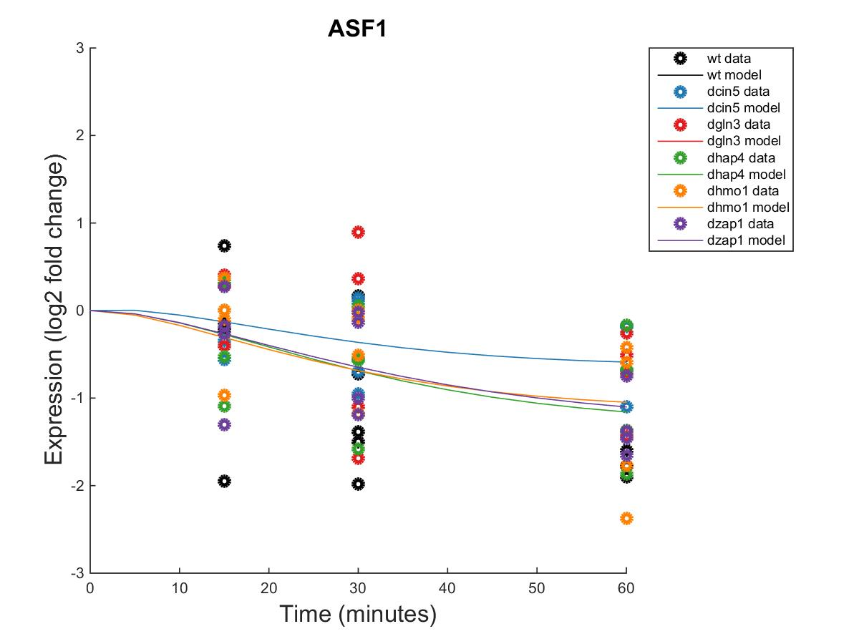
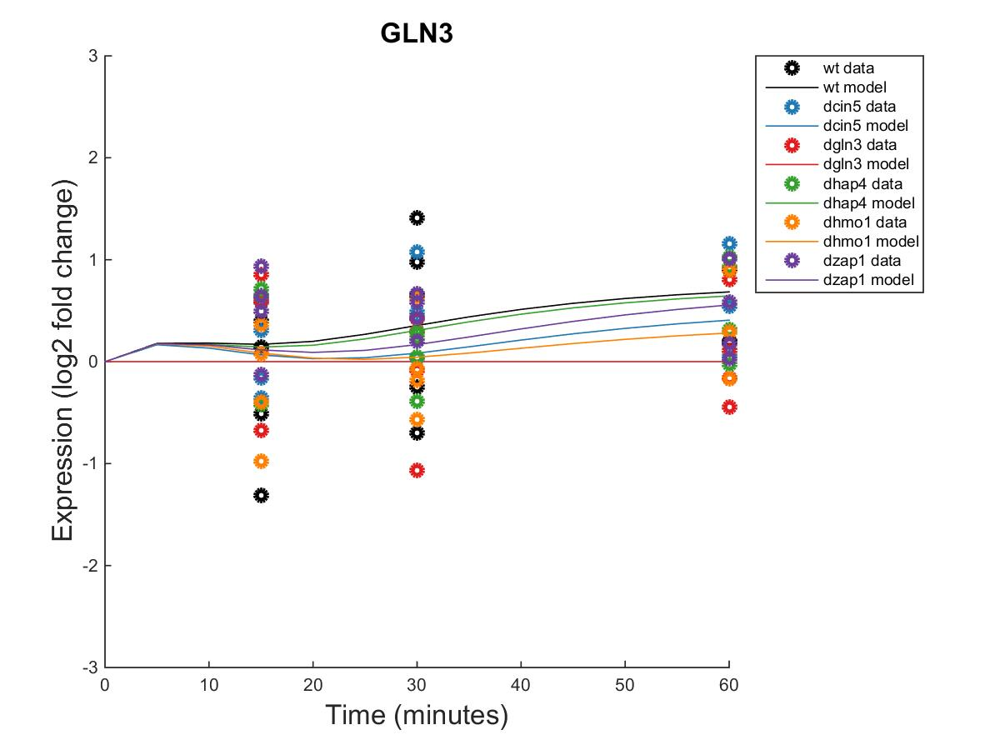
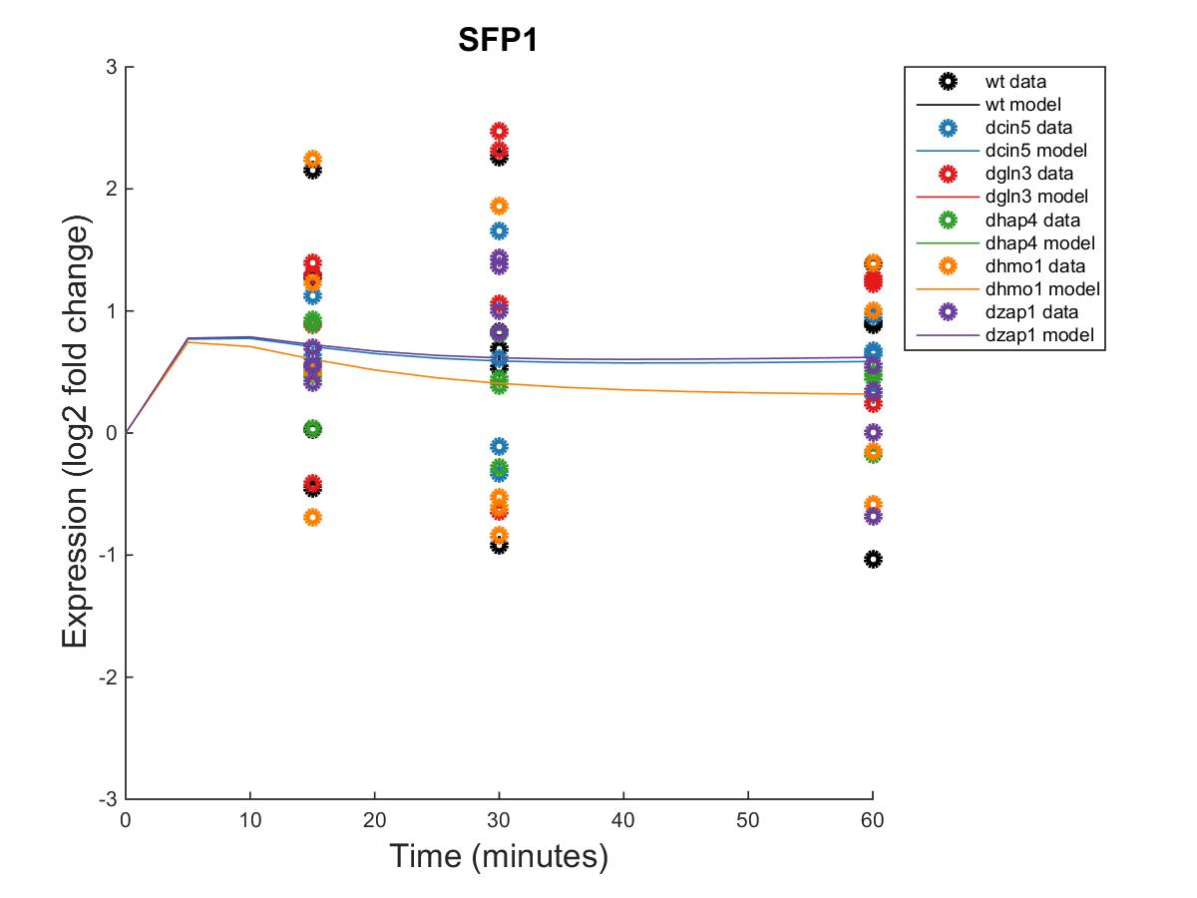
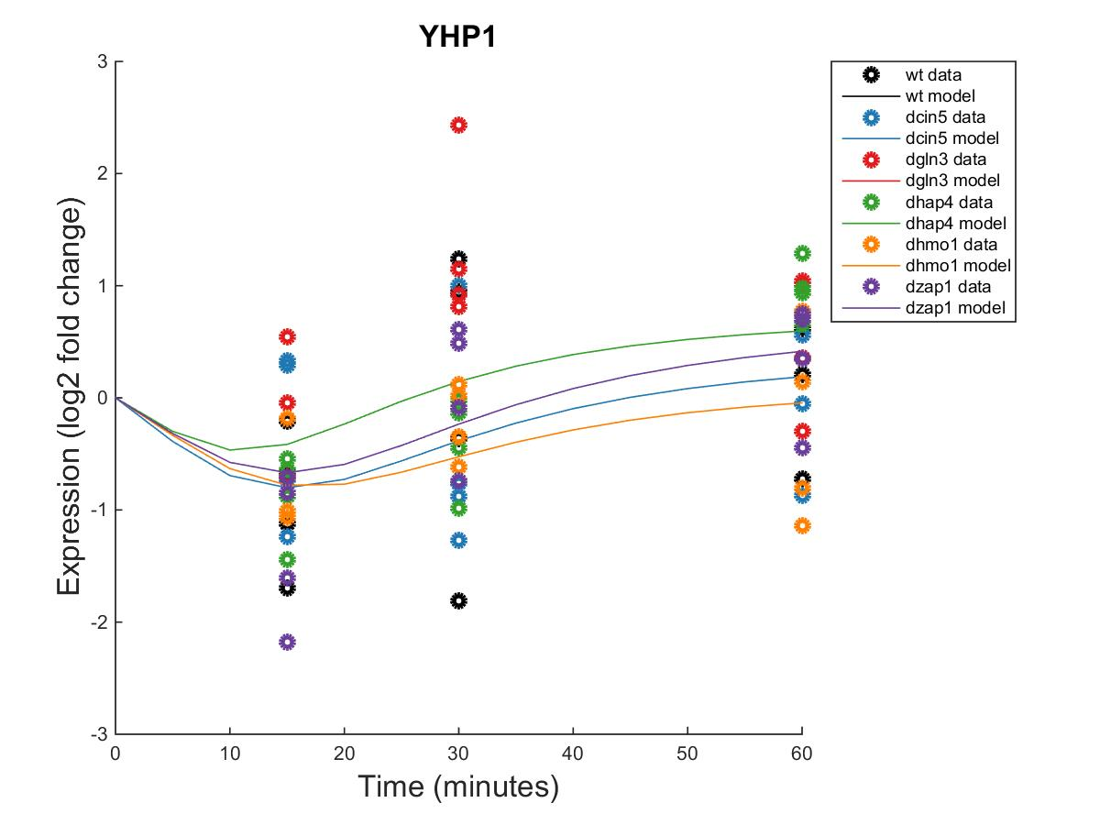
A
Within Strain ANOVA
0.0298
0.4193
0.4165
0.2305
0.8447
0.1669
B
Within Strain ANOVA
0.4189
0.5468
0.6094
0.5189
0.9281
0.1171
MSE:minMSE = 0.3695
MSE:minMSE = 0.2209
C
Within Strain ANOVA
0.4097
0.0494
0.0751
0.0533
0.8354
0.0021
D
Within Strain ANOVA
0.1743
0.8684
0.0433
0.0084
0.8152
0.0653
MSE:minMSE = 0.5337
MSE:minMSE = 0.3662
Notes:
Figure 2

Slide 4
Network:
Network:
A
B
Notes:
Figure 3

Slide 5
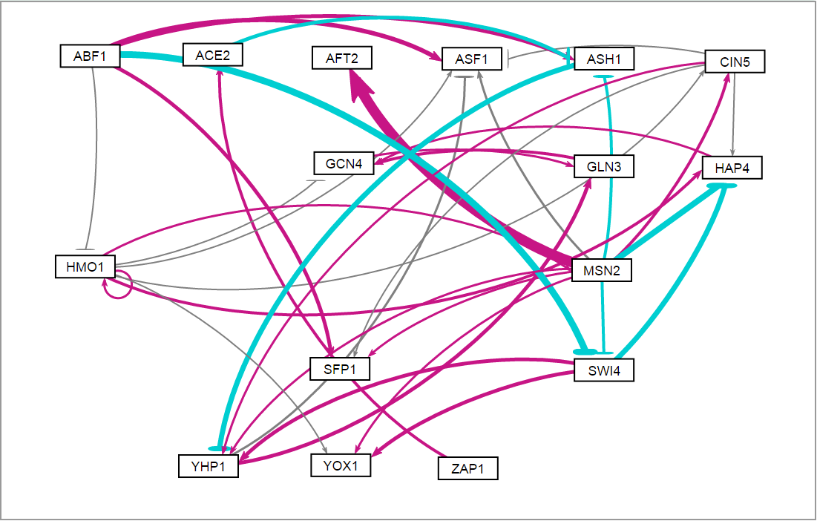
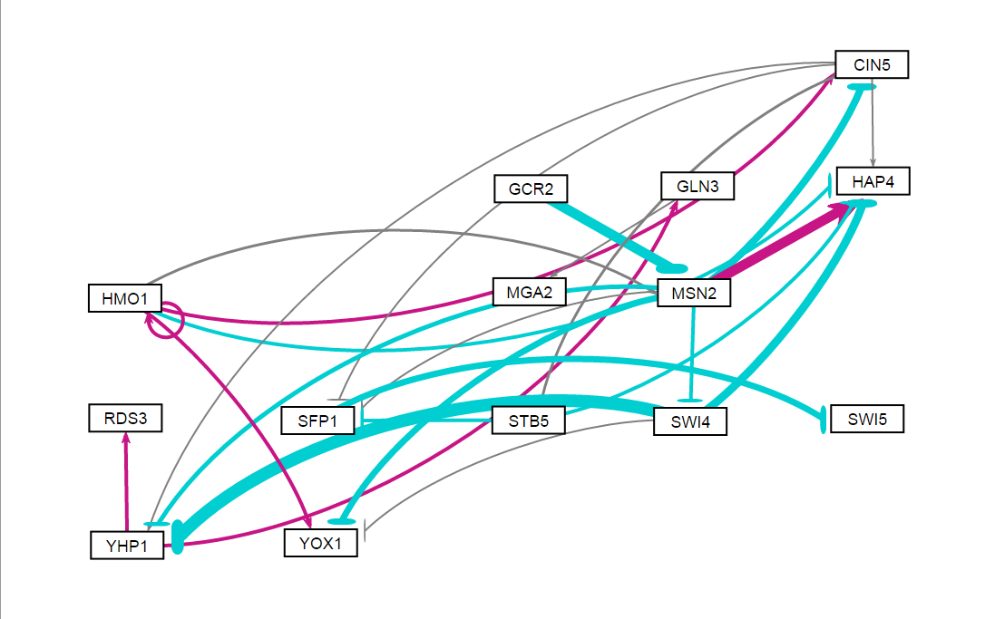
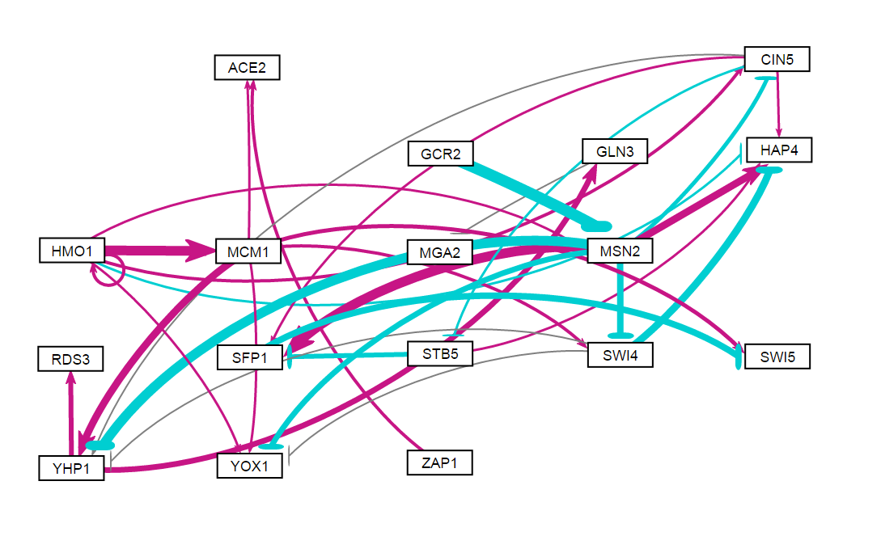
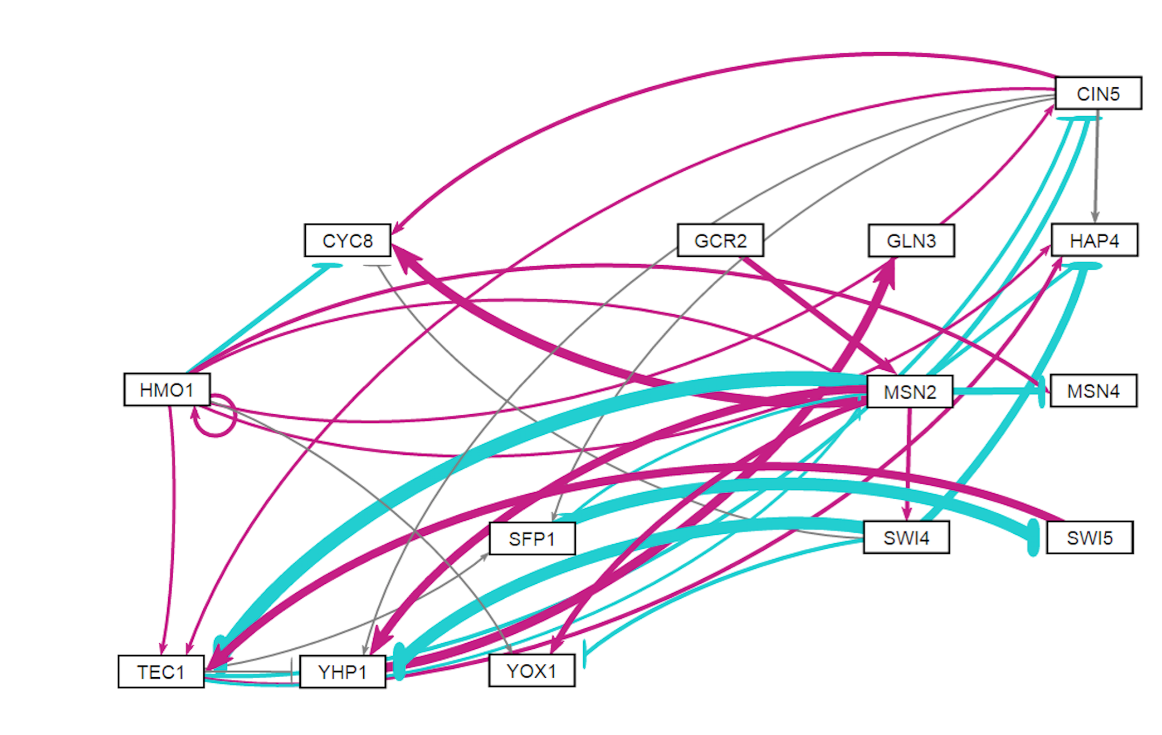
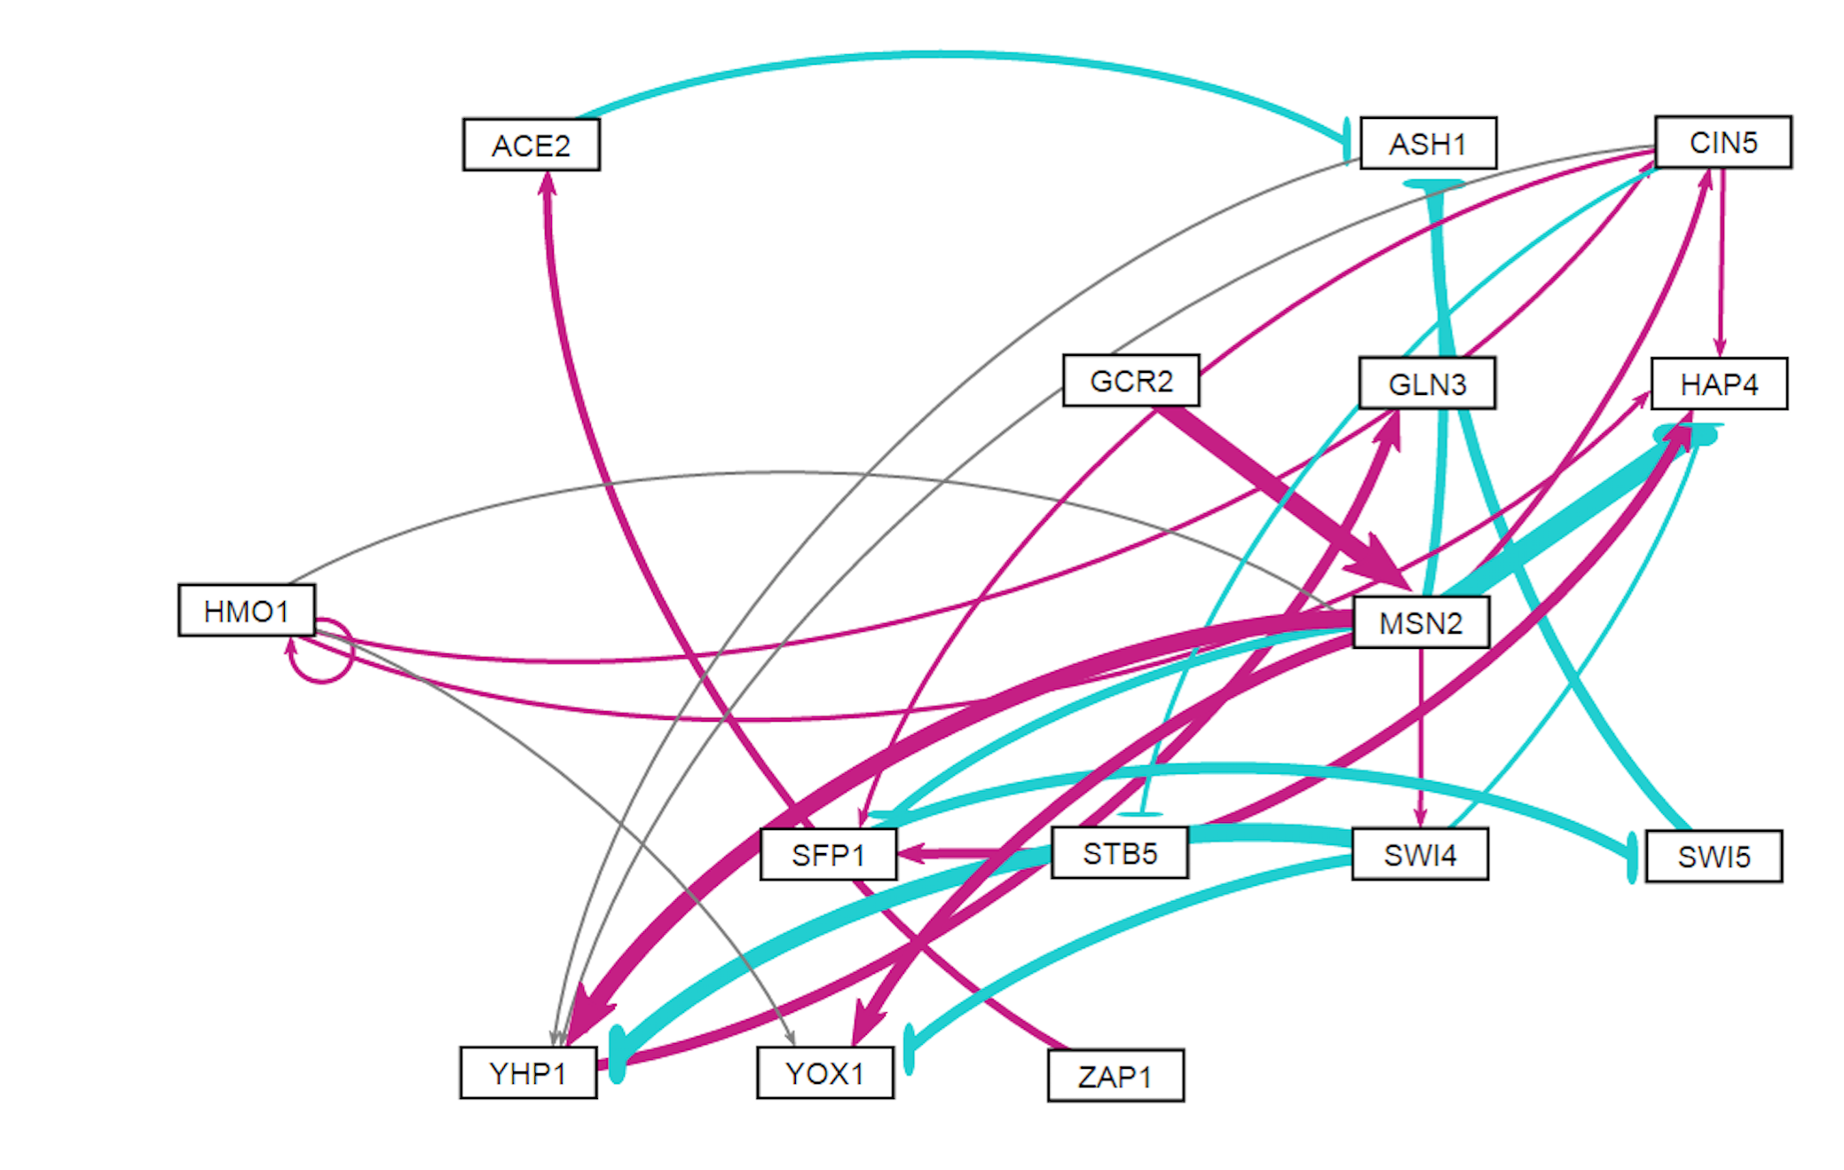
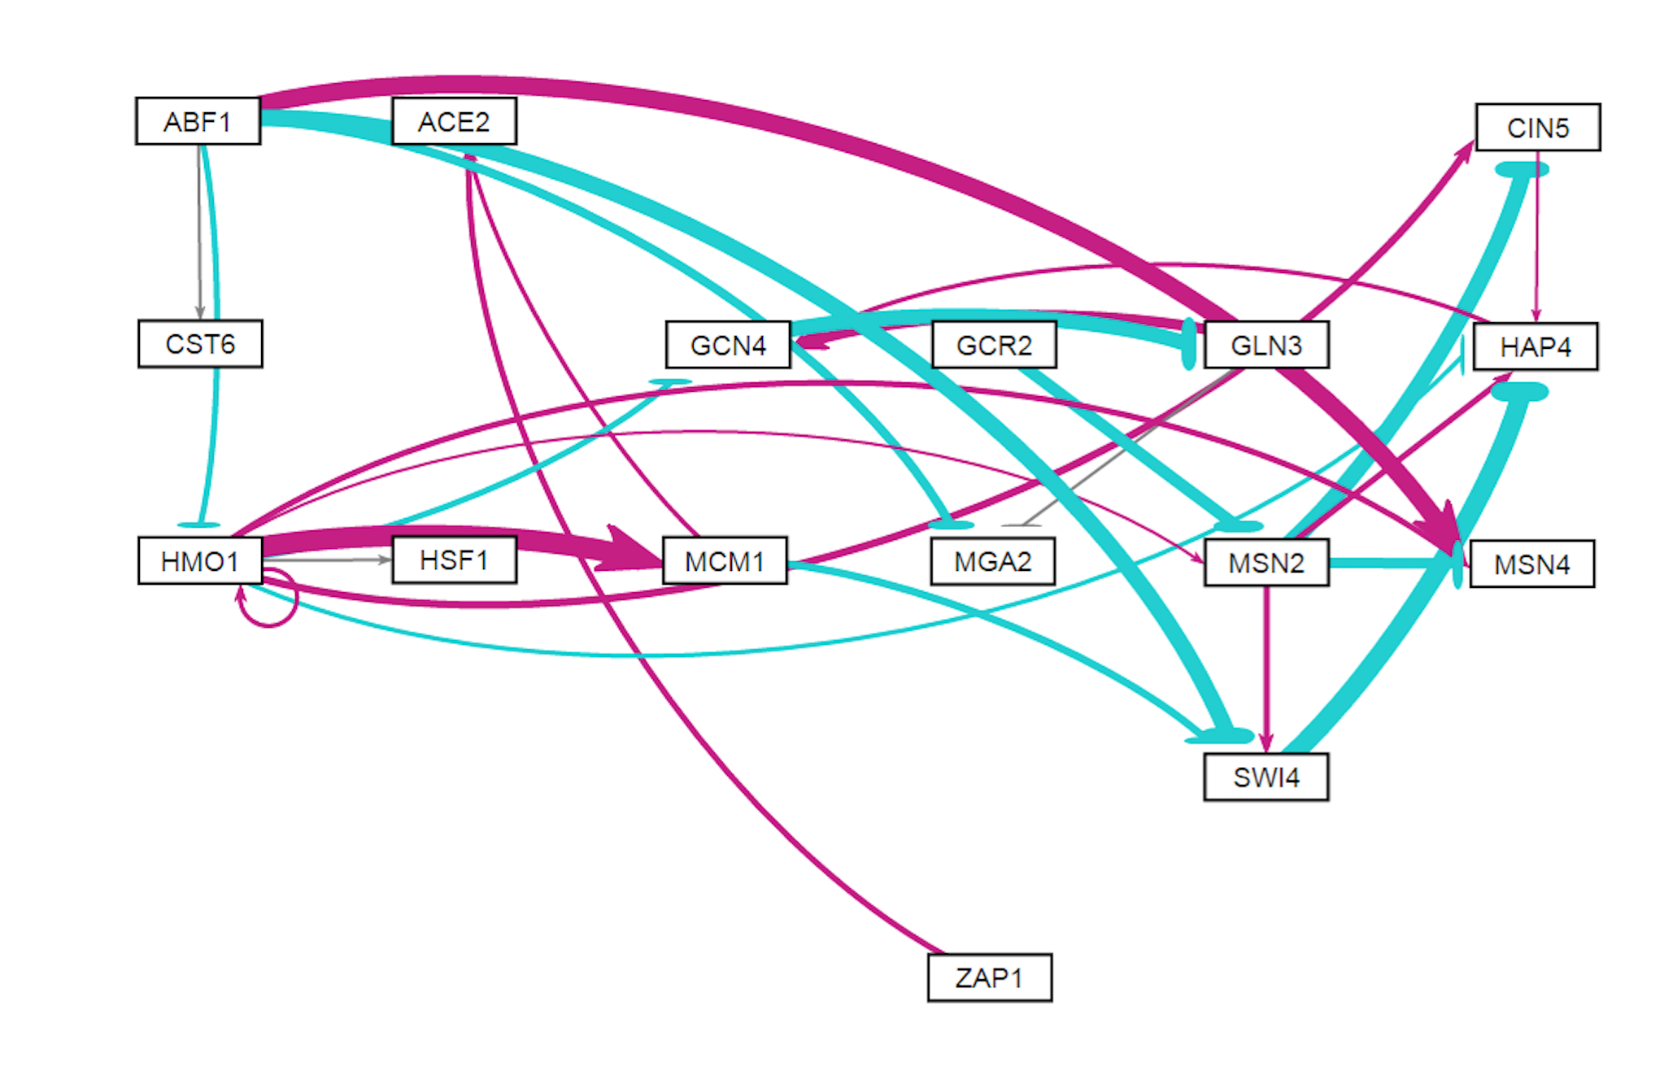
db1: Network Derived from wt Data
16 Genes, 26 Edges
LSE:minLSE = 1.42
db2: Network Derived from ∆cin5 Data
14 Genes, 25 Edges
LSE:minLSE = 1.36
db3: Network Derived from ∆cin5 Data
17 Genes, 32 Edges
LSE:minLSE = 1.41
db4: Network Derived from ∆gln3 Data
14 Genes, 35 Edges
LSE:minLSE = 1.30
db5: Network Derived from ∆hap4 Data
15 Genes, 28 Edges
LSE:minLSE = 1.43
db6: Network Derived from ∆zap1 Data
16 Genes, 27 Edges
LSE:minLSE = 1.40
Notes:
Figure 6

Slide 6
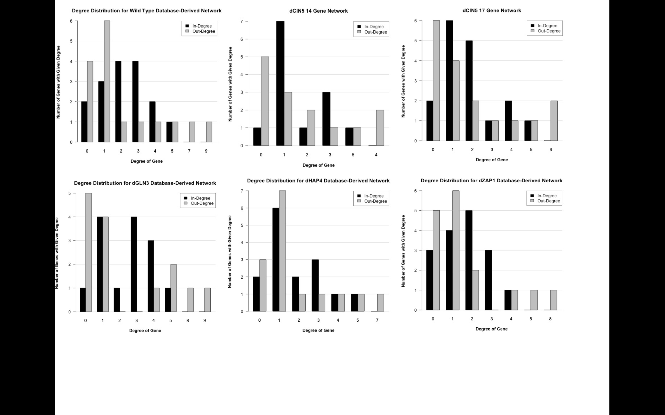
db1
db2
db3
db4
db5
db6
Notes:
Figure 7

Slide 7
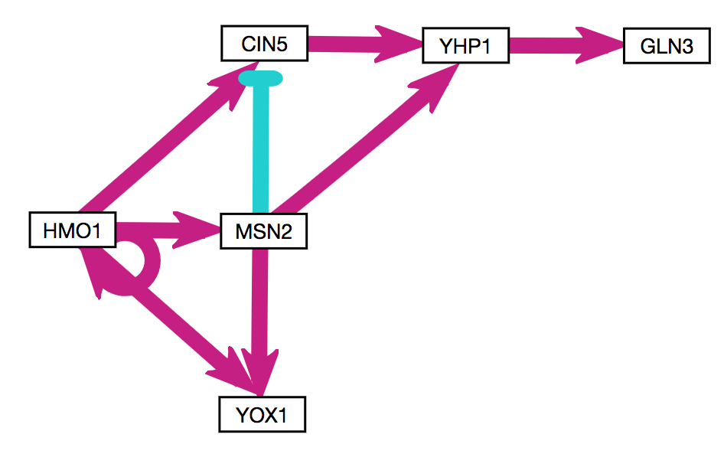
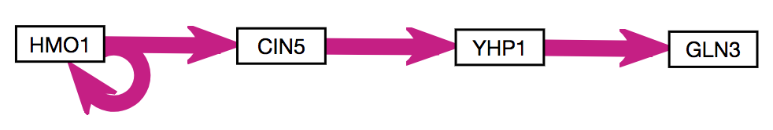
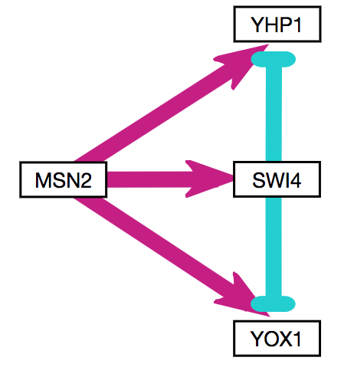
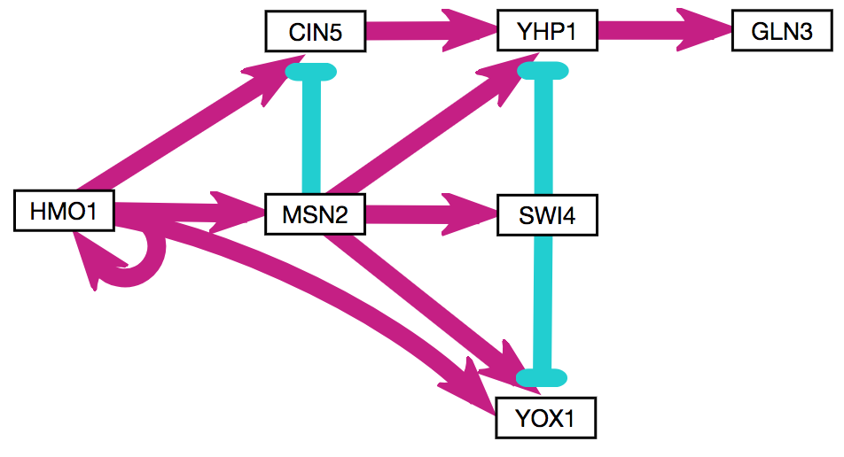
A
B
C
D
Notes:
Figure 8

Slide 8
Network:
A
Network:
B
Notes:
Figure 9

